Slide 1
NYC Green CAB DATA ANALYSIS AND RECOMMENDATION
-SOHAM TALUKDAR

Slide 2
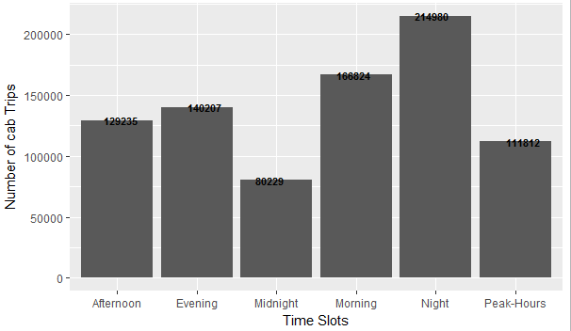
RECOMMENDATION BASED ON TIME SLOTS
The Data has been divided into TIME SLOTS namely(MORNING,PEAK-HOURS(7-11 am),NOON(12-4 pm),EVENING(4-7 pm),NIGHT(7-12 pm) and midnight(12-4 am)
For example this is the number of pickups for each slot over the duration of 1st Feb to 14th Feb.

Slide 3
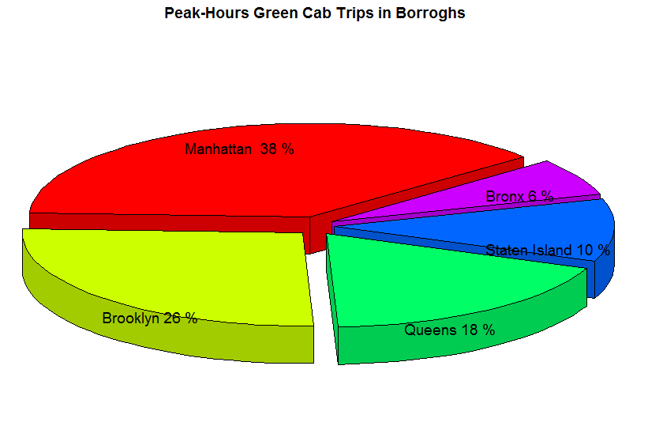
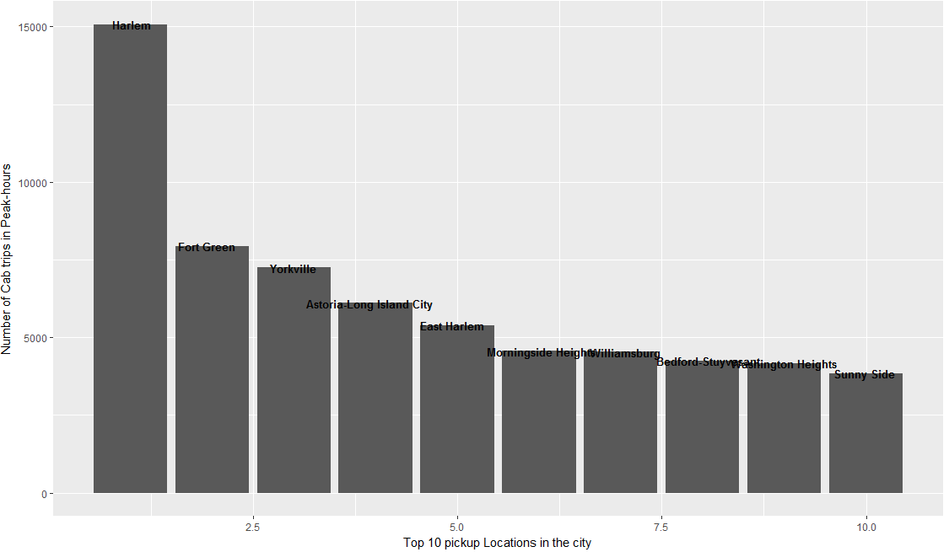
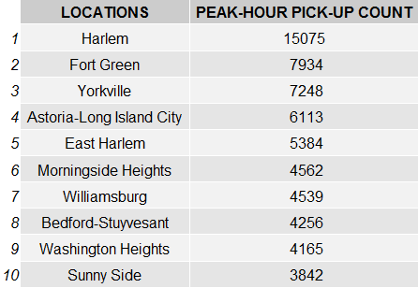
PEAK-HOUR GREEN CAB pickup locations
(7:00 Am to 11:00 AM)
So these graphs represent which borroghs call for green cabs more than others and which exact locations get more green cab pickups than others.

Slide 4
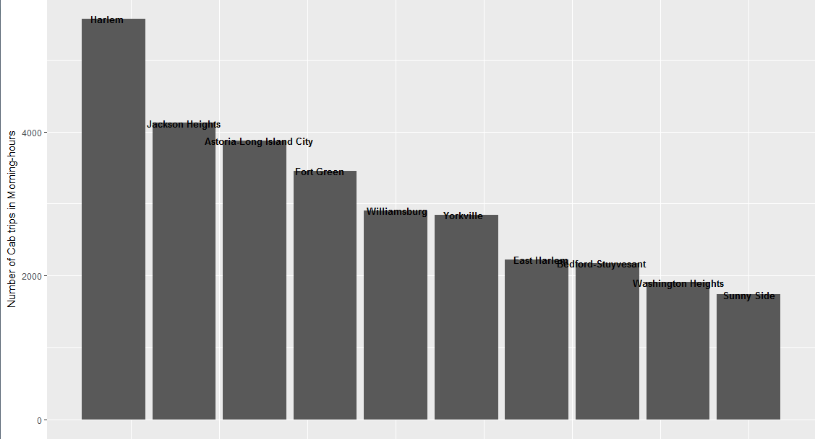
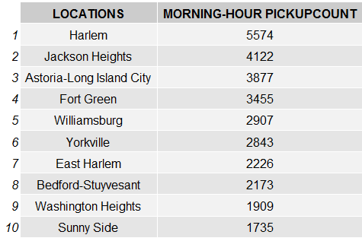
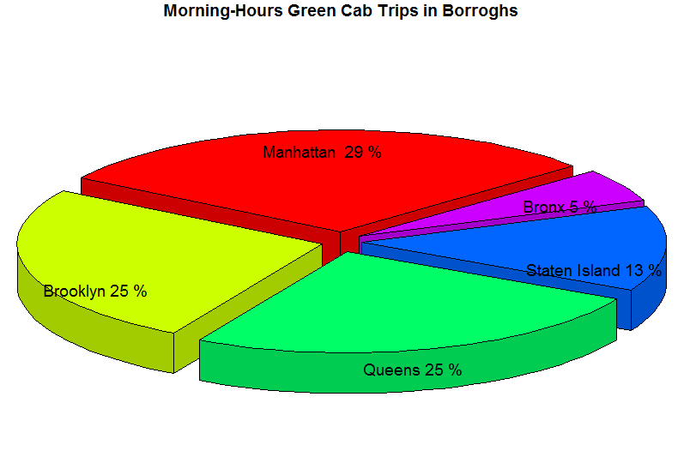
MORNING TIME GREEN CAB pickup locations
(4:00 Am to 12:00 pM excluding peak hours)
So these graphs represent which borroghs call for green cabs more than others and which exact locations get more green cab pickups than others.

Slide 5
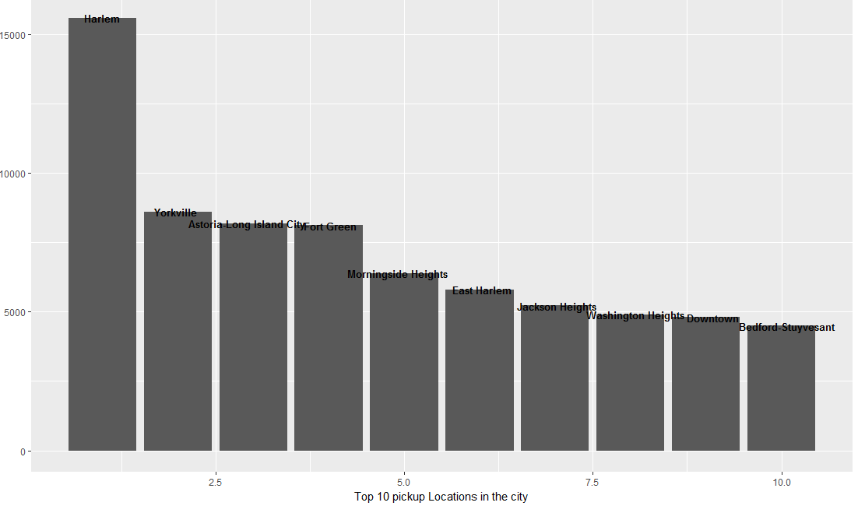
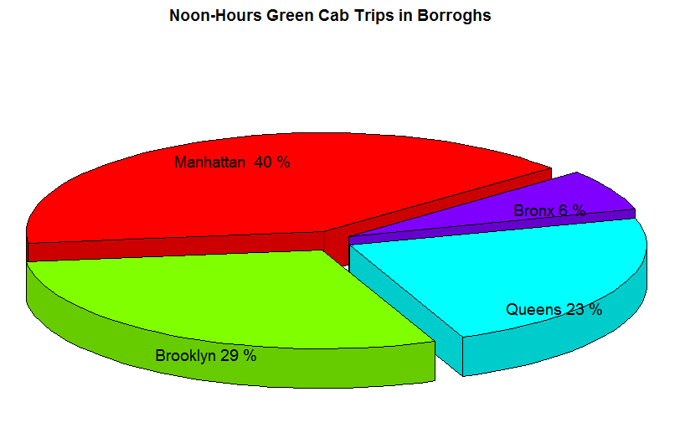
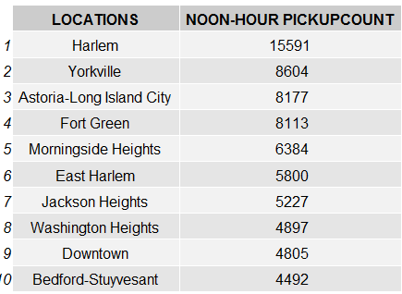
NOON TIME GREEN CAB pickup locations
(12:00 Pm to 4:00 AM

Slide 6
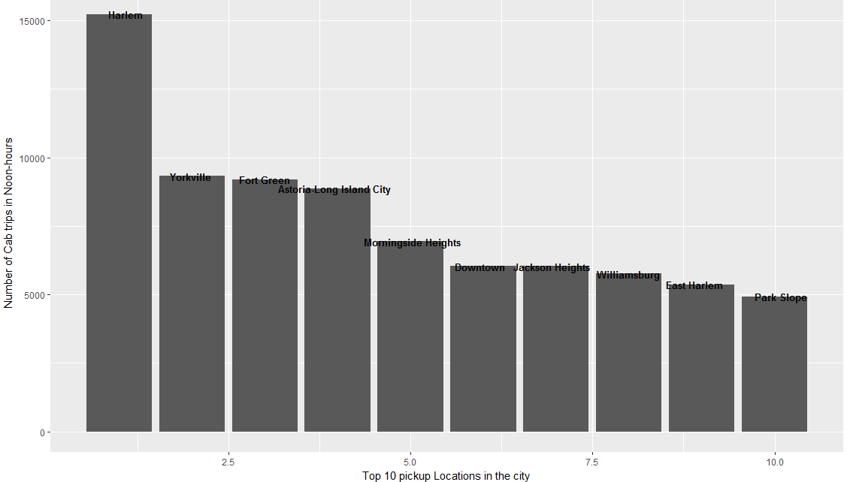
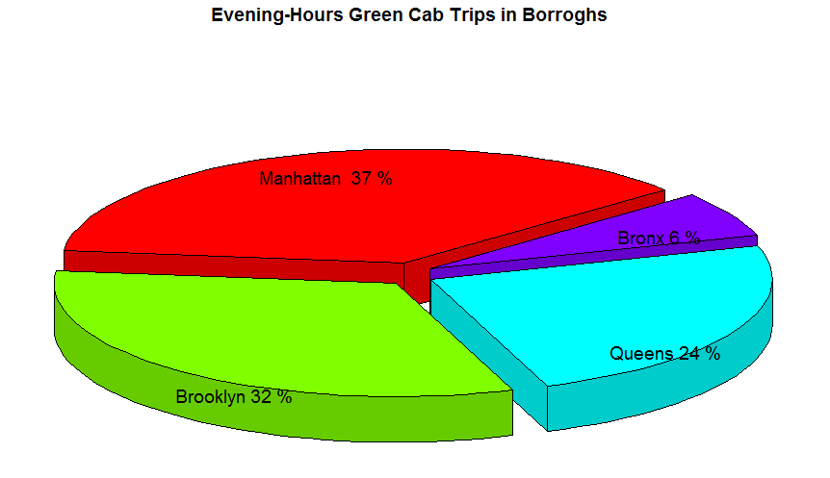
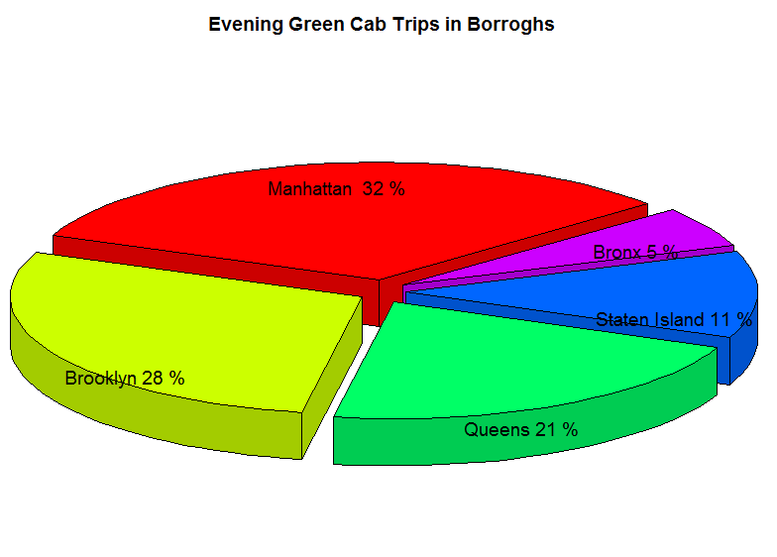
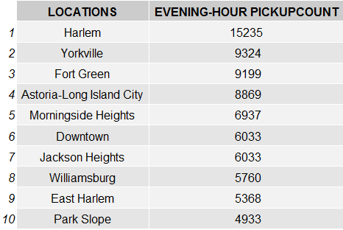
EVENING TIME GREEN CAB pickup locations
(4:00 Pm to 7:00 pM)

Slide 7
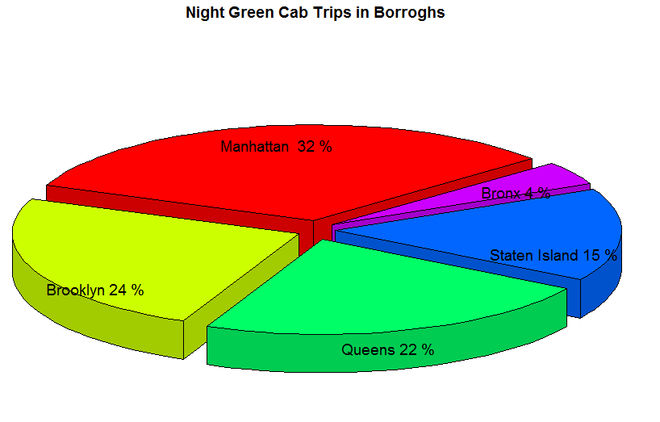
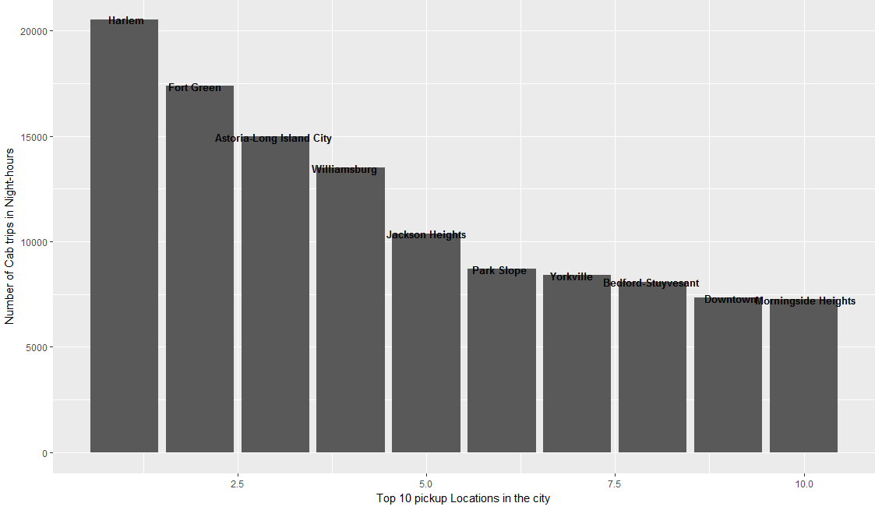
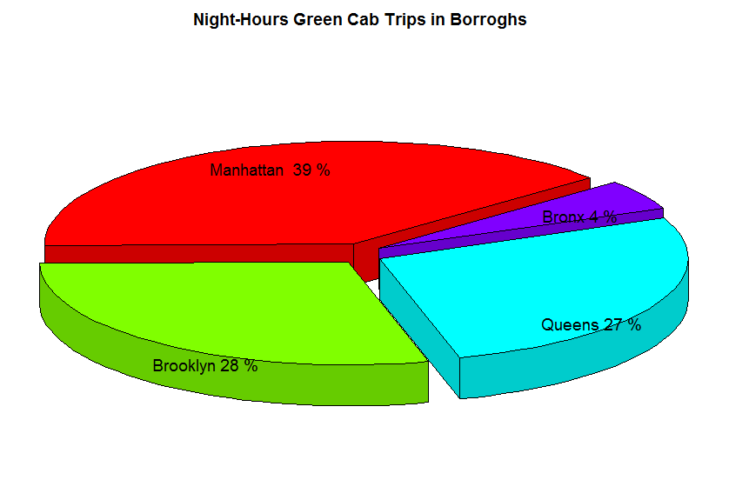
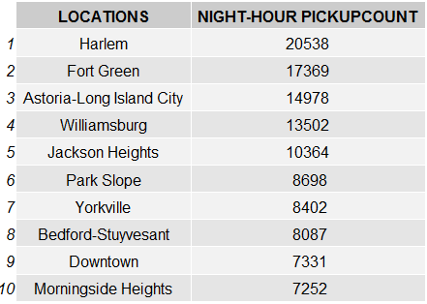
NIGHT TIME GREEN CAB pickup locations
(7:00 Pm to 12:00 AM)

Slide 8
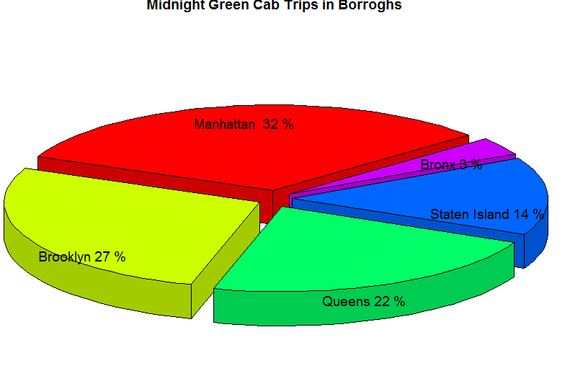
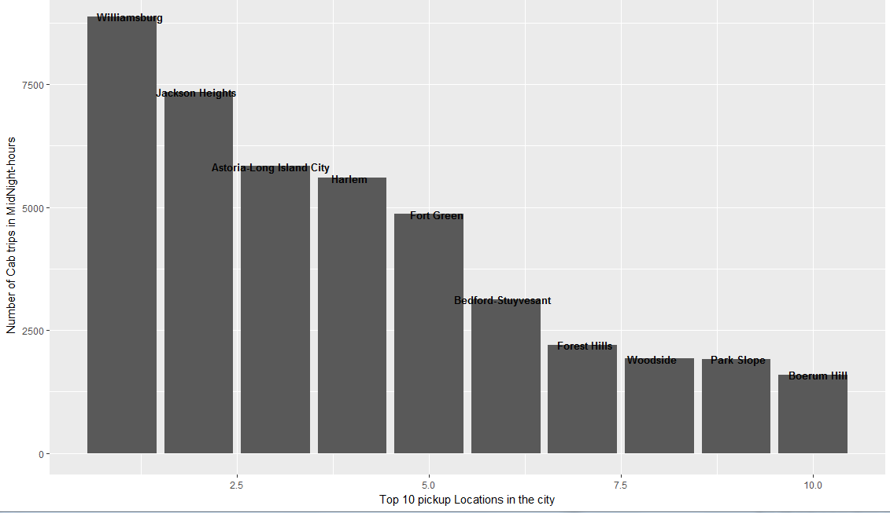
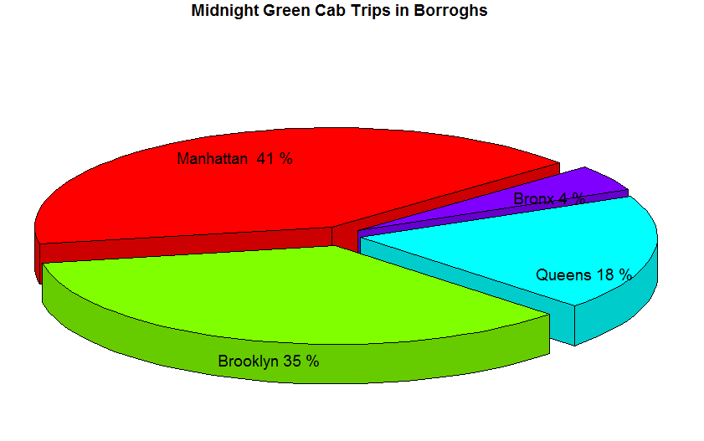
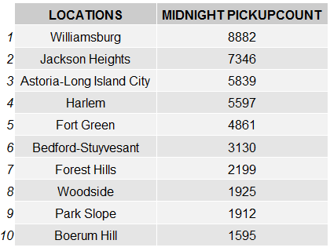
MIDNIGHT GREEN CAB pickup locations
(12:00 Am to 4:00 AM)

Slide 9
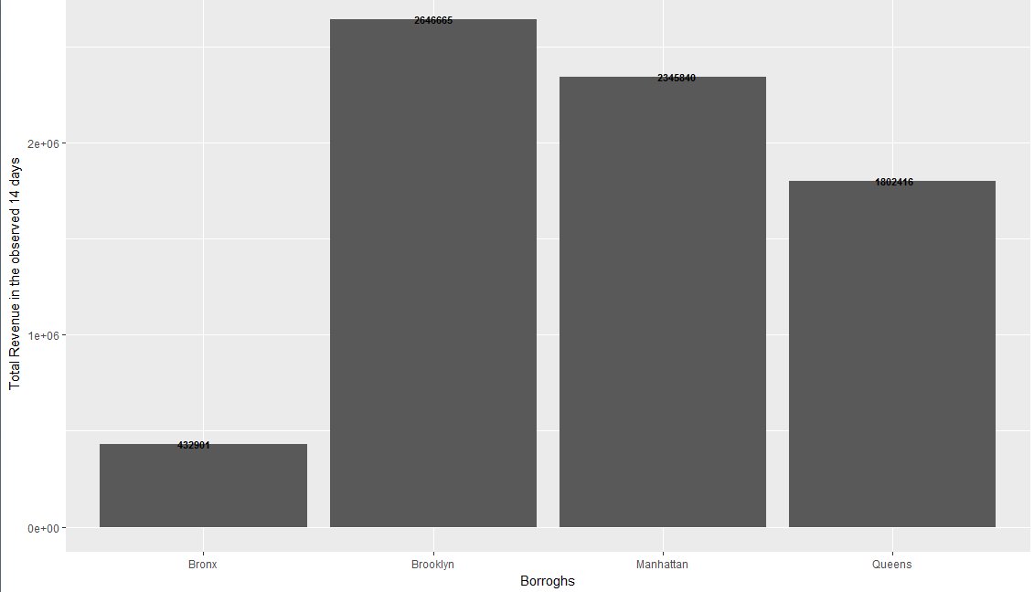
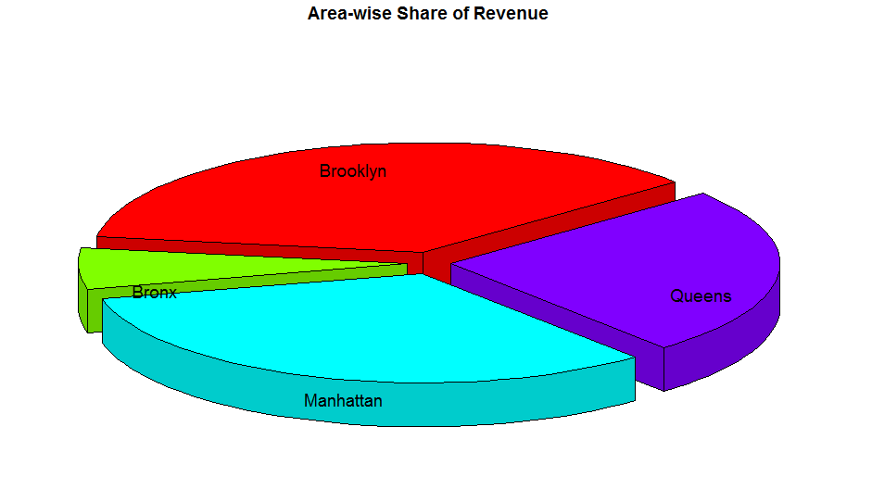
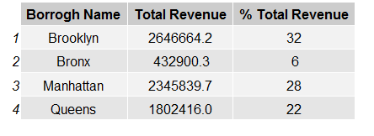
Fare and tip amounts in burroghs

Slide 10
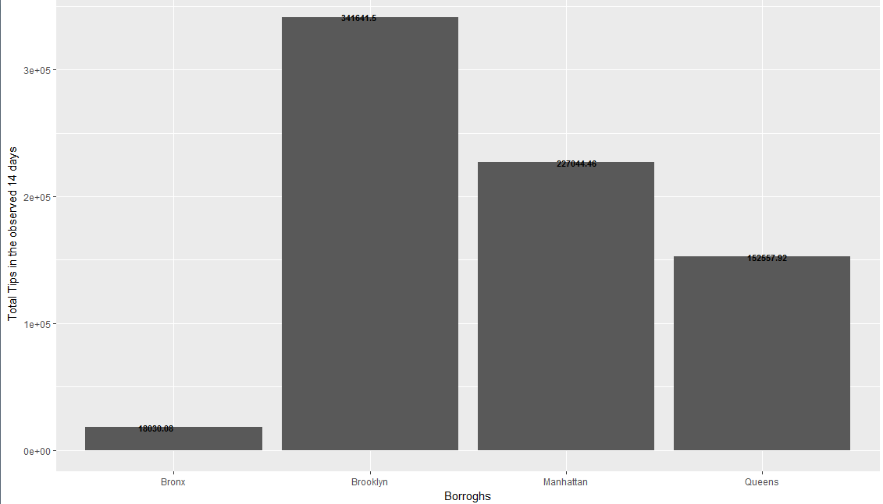
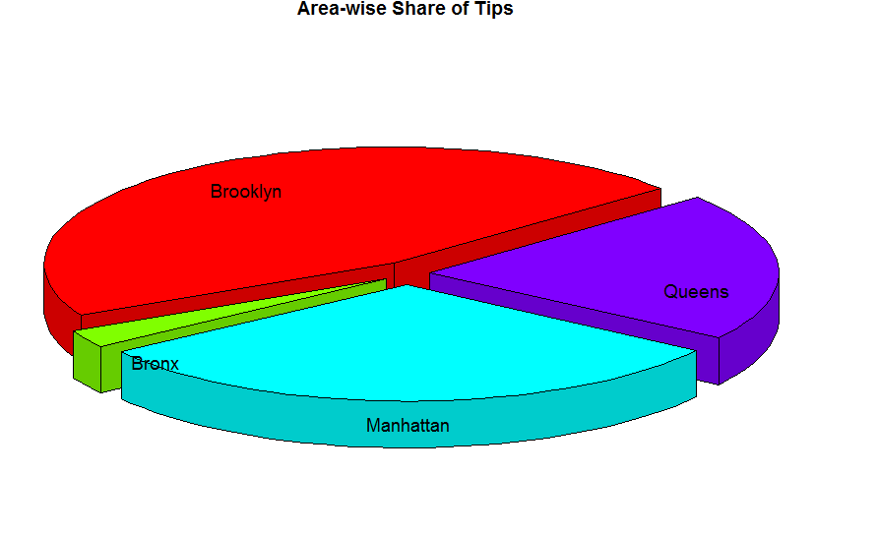
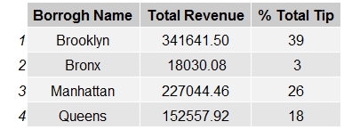
TIPS

Slide 11
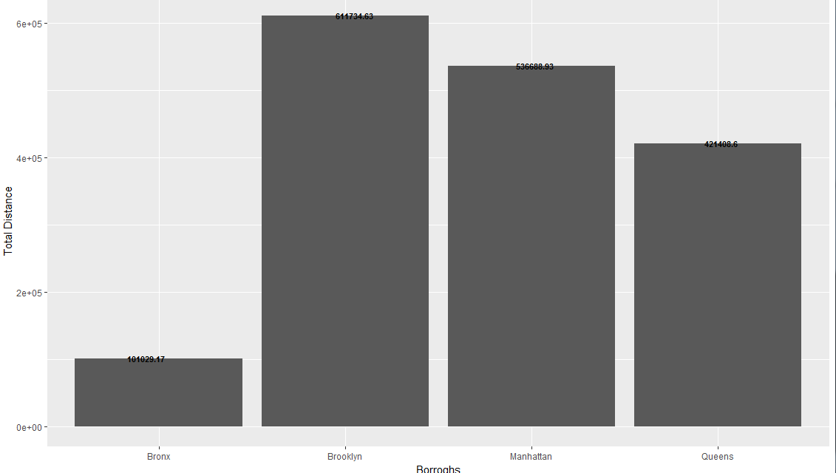
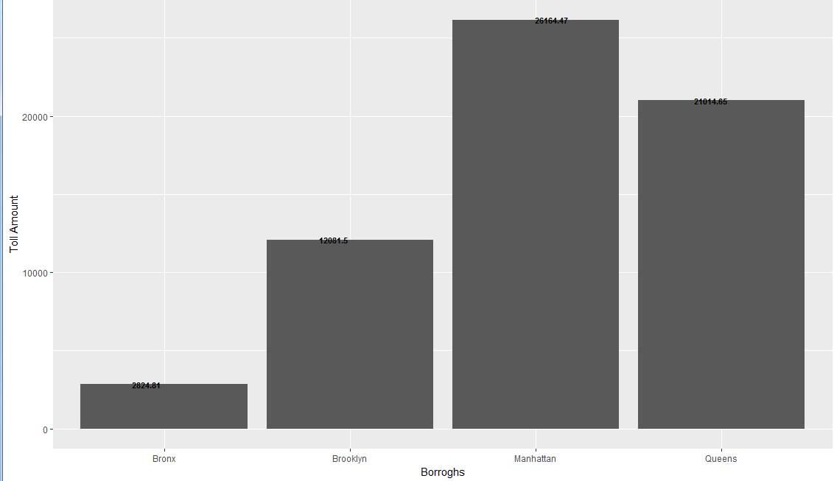
Total Distance and total toll amount

Slide 12
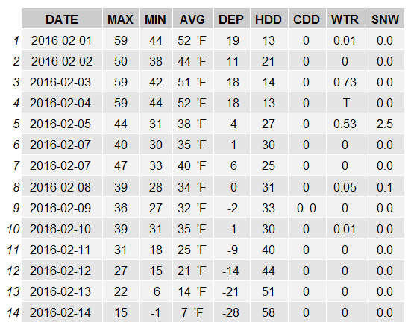
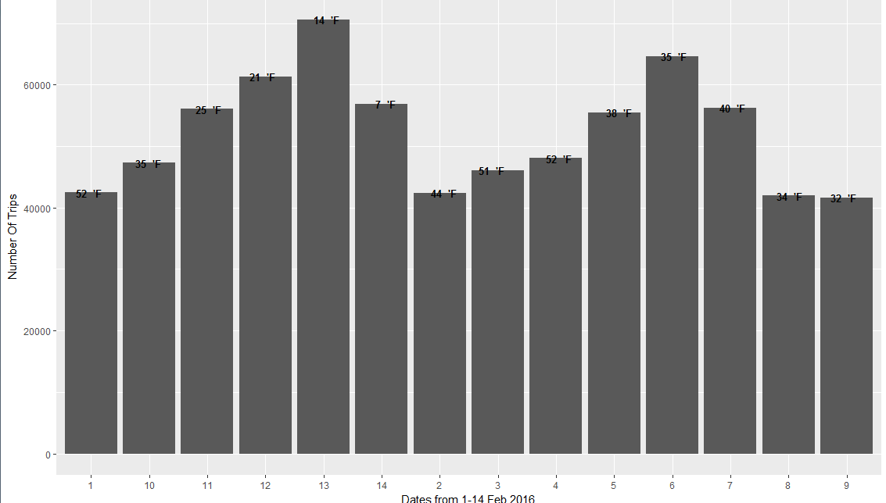
Weather vs green cabs

